Slide 1

Internet Programming I
Chapter 4
JavaScript: Frameworks
Group:1
3rd Year Sec B Students,
Dept. of Software Eng.
Feb 2022, AASTU

Slide 2

Objectives
After success completion of the session you will be able to:
Define a framework
List some JavaScript frameworks currently available
Difference between JavaScript library and JavaScript Frameworks
Features and components of respective frameworks
Comparing different form of Frameworks
How to choose the best frameworks

Slide 3
Outline
Java Script Framework
General information on framework
What is Java Script framework
Uses of Java Script framework
Difference between JS library and Framework
Most popular JS Frameworks and their key components
Comparison of JS Frameworks
Summary

Slide 4
1. What is Framework
Framework
A framework is a structure that you can build software on. It serves as a foundation, so you're not starting entirely from scratch. Frameworks are typically associated with a specific programming language and are suited to different types of tasks.
Using a software framework to develop applications lets you focus on the high-level functionality of the application. This is because any low-level functionality is taken care of by the framework itself.
Notes:
Let's say you're building a house. You could pour the foundation and frame the house yourself. It would take a lot of time, but you could do it. If all of that were already done for you, though, it would save you quite a bit of effort — especially if it was done by expert home builders.

Slide 5
2. Why do we use frameworks?
Using frameworks saves time and reduces the risk of errors. You don't need to write everything from the ground up, so there's less chance of introducing errors.
Plus, frameworks have already been tested, so there's less to worry about. Other advantages include:
More secure code
Simpler testing and debugging
Avoiding duplicate code
Clean and easily adaptable code
Able to focus on writing code specific to the project
The time required to develop an application is reduced significantly
Several code segments and functionalities are pre-built and pre-tested. This makes applications more reliable.

Slide 6
3. Types of Framework
Web application frameworks
Angular is a typescript-based, open-source JS framework that makes it easy to build applications on the web.
Django is a free and open-source web application framework written in Python.
Laravel is a PHP-based web application framework with an expressive, elegant syntax.
Mobile Development Frameworks
Flutter is Google’s UI toolkit for building beautiful, natively compiled applications for mobile, web, and desktop from a single codebase.
Ionic is a free, open-source mobile UI toolkit for developing high-quality, cross-platform native applications for Android, iOS, and the Web—all from a single codebase.
Notes:
There are many types of software frameworks to make it easier for developing applications for a wide range of application development domains. Let us dive into some of the software frameworks that are in vogue today:

Slide 7
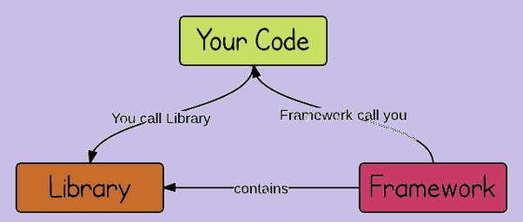
4. JavaScript libraries VS framework
A common topic of discussion in the software community is the difference between a framework and a library. In truth, experts have suggested that the line between them can be blurry, but it is useful to make the distinction.
While a JS framework is a full toolset that helps shape and organize your website or application, a JS library, on the other hand, is a collection of pre-written code snippets that are less about shaping your application and more about providing a use-as-needed library of features.

Slide 8


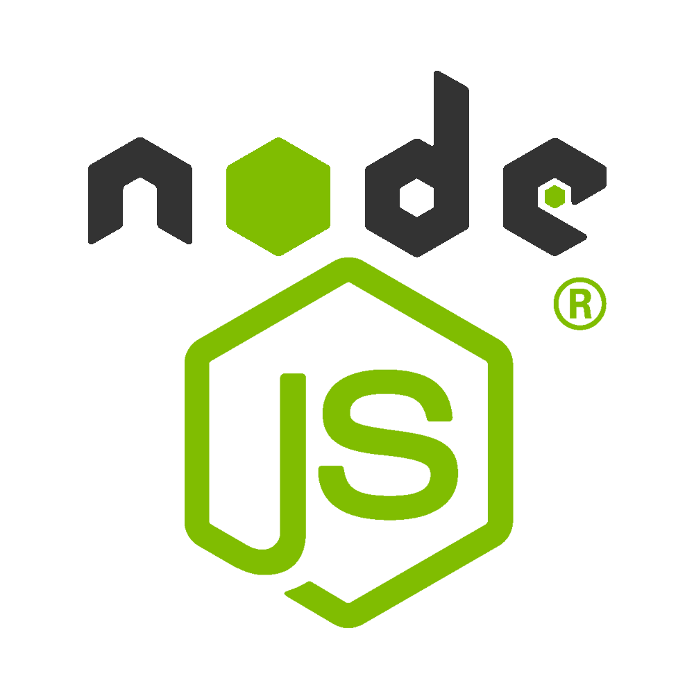



4. Some JavaScript Frameworks

Slide 9
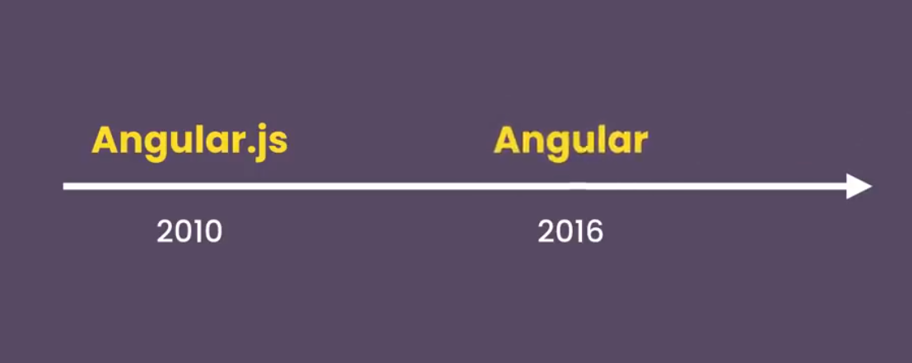
5. Angular
AngularJS is a JavaScript MVC client-side framework for creating dynamic web applications. AngularJS began as a Google project, but it is now an open-source framework.
There is no need to gain knowledge of another syntax or language because AngularJS is entirely based on HTML and JavaScript.
It is also one of JavaScript’s oldest
frameworks and was first released over
a decade ago in 2010.
Several breaking changes have been
made since it’s inception.
Notes:
It have been written by google developers and after 6 years it have been completely written in 2016. it ended the JS naming

Slide 10
5.1. Pillars of Angular
Two way binding Data:
It is the synchronization between the model and the view. ng-bind and ng-model directives provide the functionality of data-binding.
Dependency Injection:
Is technique in which an object receives other objects it depends on. Instead of attaching dependency to object Angular it injectors to dependency stored in central location. So you can reuse code and mock dependency when riding unit tests.
Directives
Directives are markers on DOM elements (such as elements, attributes, CSS, and more). It has a set of built-in directives which offers functionality to your applications. We can also create our own directives in Angular JS.
Notes:
Two way binding means model and view are synchorized.

Slide 11
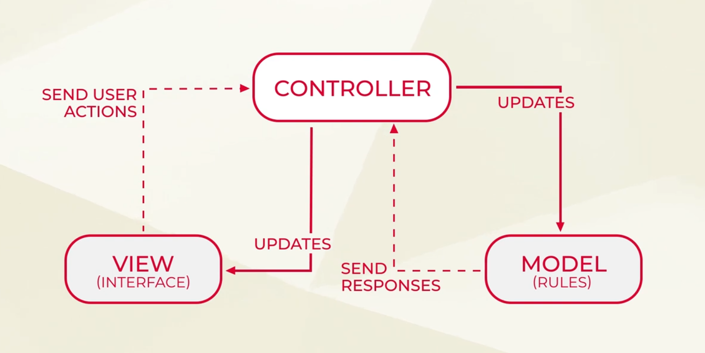
5.2. Architecture of Angular
Notes:
MVC is a software design pattern for developing web applications. It is made up of model view and controller.
Model it is the simplest method which builds without any setter and getter methods
View is responsible for viewing portions of the data to the user
Controller control the interaction between model and view.

Slide 12
5.3. Pros and Cons of Angular
Pros:
Switched to Typescript as base language which have many additional features.
Mobile development closer than ever using native script for class platform that can transfer 90% of the code.
Single page application
Some uses of framework such as less code, DOM manipulation & Code Reusability.
Cons:
Not Secure. Server-side authentication and authorization are required to keep the application secure.
Not degradable.
JavaScript support is mandatory.
Difficulty in learning.

Slide 13
6.1 React
React was first created by Jordan Walke , a software engineer working for Facebook.
React is the most popular Front End JavaScript frameworks , that is based on building reusable components of the code base which makes web apps very lightweight.
React is a declarative, efficient, and flexible JavaScript library for building user interfaces.
It lets you compose complex UIs from small and isolated pieces of code called “components”.

Slide 14
6.1 Properties of React
React.js properties includes the following properties:-
React.js is declarative
React.js is simple
React.js is component based
React.js supports server side
React.js is extensive
React.js is fast
React.js is easy to learn

Slide 15
6.3 Pro and cons of React
Pros:
The frameworks count with a virtual DOM. It transforms the real DOM into a virtual one. Allowing developers to execute code faster and makes the user interface better. The data is unidirectional, meaning that the data flow one-way. Child elements do not affect parent elements.
React uses JSX. It also reuses code components, allowing developers to create components that don´t have to be built multiple times. The development process is fast and precise.
Cons:
Developers say that the documentation for React.js could be better. The catalog is a framework with poor documentation. The platform advances faster than what they document.
The learning curve is steep, meaning that it is not so easy to learn the framework.

Slide 16
7. Vue Js
Vue JS: With the help of Vue.js, we can create UIs(User Interfaces) and SPAs(Single-page Applications) because it is a progressive JavaScript framework. Its a very easy framework and we can make web applications in it with little knowledge of HTML, CSS, and JavaScript.
Vue.js itself is not full-blown framework. It is focused on the view layer only. It is therefore easy to pick up and integrate with other libraries or existing projects.
On the other hand when used in combination with proper tooling and supporting libraries, Vue JS is also perfectly capable of powering sophisticated SPA.

Slide 17
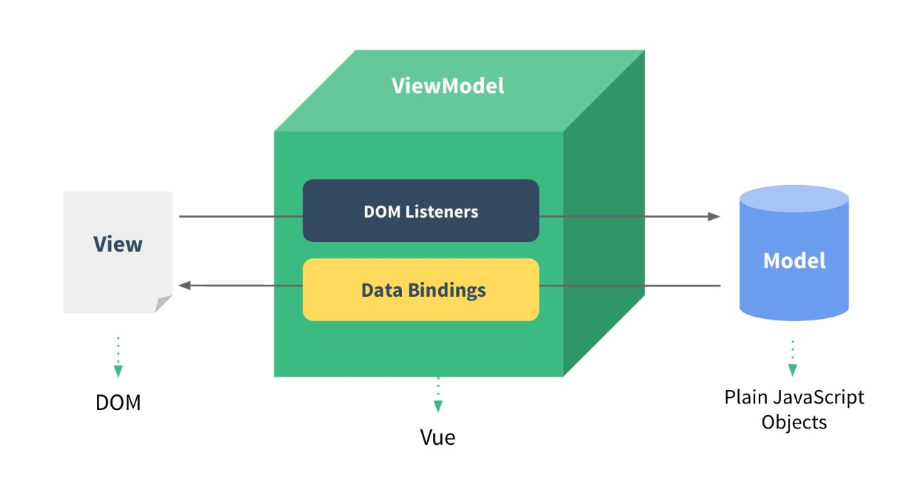
7. Vue Js
Reactive Data Binding
At the core of Vue.js is a reactive data-binding system that makes it extremely simple to keep your data and the DOM in sync.
It means we use special syntax in our normal HTML templates to “bind” the DOM to the underlying data.
Once the bindings are created, the DOM will then be kept in sync with the data. Whenever you modify the data, the DOM updates accordingly.
Notes:
When using jQuery to manually manipulate the DOM,the code we write is often imperative, repetitive and error-prone.
As a result, most of our application logic is now directly manipulating data, rather than messing around with DOM updates. This makes our code easier to write, easier to reason about and easier to maintain. Vue.js embraces the concept of data-driven view .

Slide 18
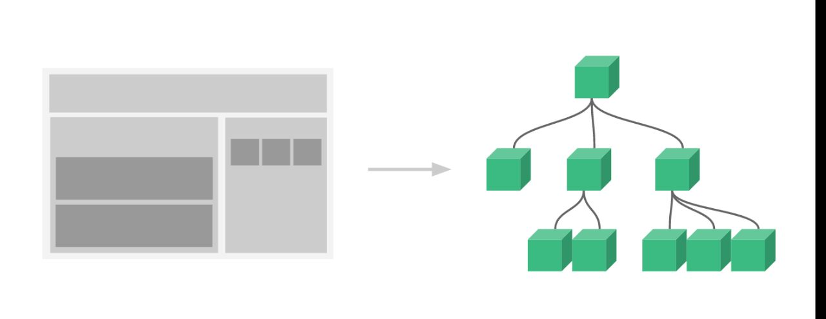
7. Vue Js
Component System
The Component System is another important concept in Vue.js, because it’s an abstraction that allows us to build large-scale applications composed of small, self- contained, and often reusable components.

Slide 19
7.1 Pro and cons of Vue
Pros:
Vue JS uses HTML templates
Data is gathered with the DOM
The data is transferred in Bi-Directional
Vue JS is more Reactive than others
It is simple to integrate with other frameworks.
Cons:
It overcomplicates the developer by its flexibility.
It is the latest library and the developers are fewer.

Slide 20
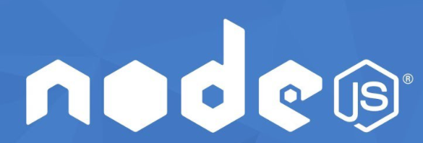
Backend JS frameworks
Node.js is a runtime environment that helps run JavaScript on servers. It takes the chrome v8 engine and compiles the JavaScript code on the servers.
Node.js helps developers build applications on server-side, desktop, and mobile applications. Having Node.js as the base, a lot of frameworks have evolved in recent years.
Some of the popular websites like Netflix, eBay, PayPal, and LinkedIn use Node.js in their application development
85% of developers use Node.js to develop web applications.
Since Node.js uses JavaScript to build the backend, it’s easy for JavaScript developers to create a complete product.

Slide 21
Backend JS frameworks
EXPRESS
Express.js is a flexible, minimalistic, lightweight, and well-supported framework for Node.js applications. It is likely the most popular framework for server-side Node.js applications.
Express provides a wide range of HTTP utilities, as well as high-performance speed. It is great for developing a simple, single-page application that can handle multiple requests at the same time.
NEXT.JS
Next.js is a minimalistic framework that allows a JavaScript developer to create a server-side rendering and static web applications using React.js. It is one of the newest and hottest frameworks that takes pride in its ease of use.
Many of the problems developers experience while building applications using React.js are solved using Next.js. It has many important features included “out of the box,” and makes development a JavaScript breeze.

Slide 22
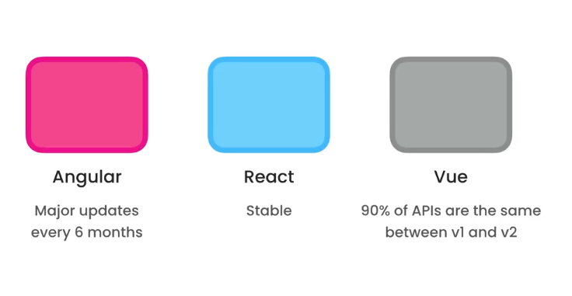
9. Comparison of JS frameworks
Performance
Learning curve:
Angular is the hard one to learn.
Vue and react are subjective to students some but in our case Vue is more easy.
Talent Availability
React have more developers while Vue and angular are little bit less
Major Update for Frameworks

Slide 23
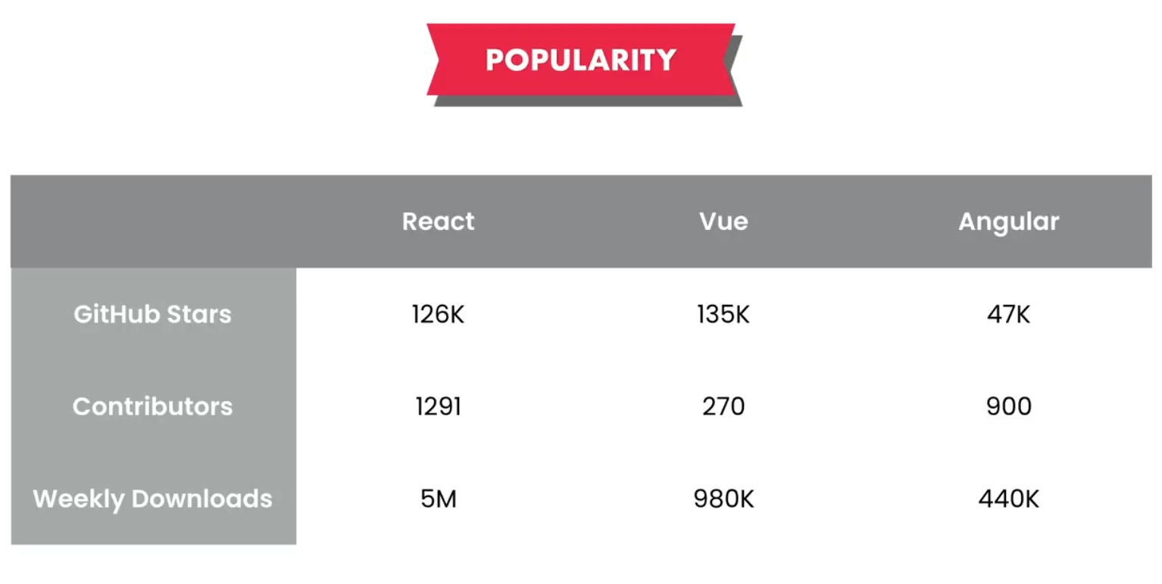
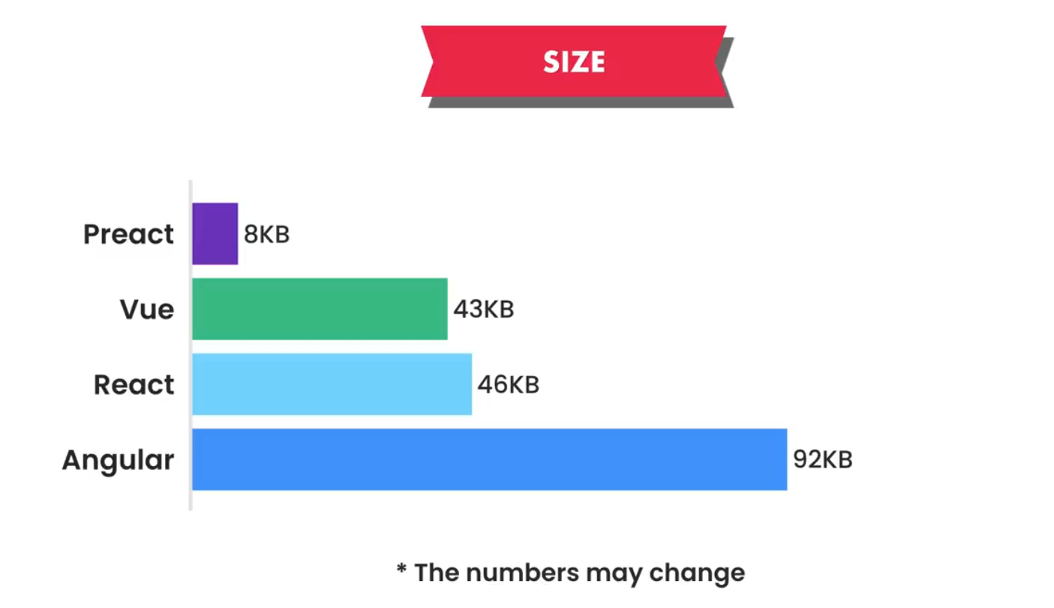
Continued
Open source community on GitHub.
Size wise

Slide 24
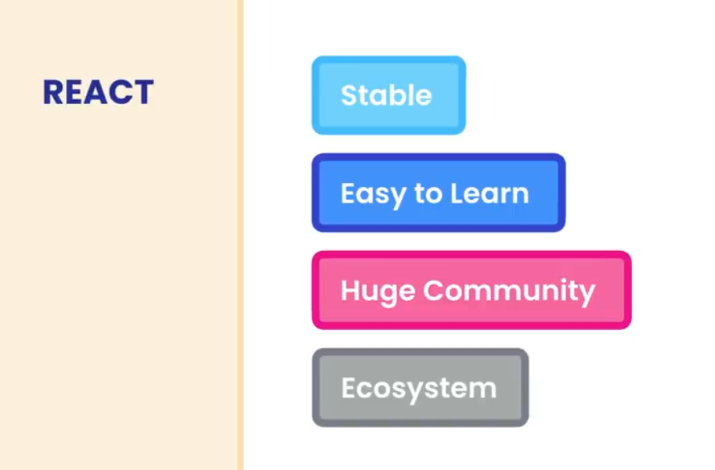
Our recommendation
Angular is full-blown Framework which means it is used in High level or enterprise level Webapps. It includes routing, testing utilities and so on.
Vue is suitable for lightweight projects you want to build by yourself
In react you don’t get much out of the box. You have to use some extra dependencies for routing and others like state management.

Slide 25
Practical Exercises
What happens

Slide 26
Reading Resources/Materials
Chapter X (if you used text book)
Jon Duckett; HTML and CSS Design and Build Websites, 2011 John Wiley & Sons, Inc., Indianapolis, Indiana
Links
Paul Deitel,

Slide 27

Thank You
For Your Attention!!

